Slide 1
Office Solutions Development
Topic 7:
Using Macros in Microsoft Access
Notes:
NCC Education - Title Master

Slide 2
Scope and Coverage
This topic will cover:
  How macros can be used in Microsoft Access and how they can be created and executed.
Notes:
NCC Education - Slide Master

Slide 3
Learning Outcomes
By the end of this topic, students will be able to:
  Create a macro in Microsoft Access
  Do the following using a macro:
    Input and validate data
    Filter and find records
    Print data
    Assign a macro to a command button
    Navigate between forms and records
    Run a query
  Secure their documents against malicious macros

Slide 4
Terminology
  Terminology will be explained in the lecture, tutorial and laboratory session. You should take notes!
  Ask questions if you do not understand.

Slide 5
Uses of Macros in Microsoft Access
  Macros can be used in Access for tasks, such as:
    Data entry and data validation
    User interface macros, such as opening forms and reports and responding to button clicks.
    Filtering records
    Finding records
    Printing
    Navigating between forms and records
    Running queries

Slide 6
Objects, Actions, Events, Arguments and Conditions - 1
  A macro in Access contains an Action or list of Actions (tasks) applied to an Object in the database, e.g. a form or command button that responds to certain Events, e.g. the clicking of a command button.
  Arguments must be specified for the Actions which provide information to the Action, e.g. if the OpenForm Action is used, the Argument would tell the action which form to open.

Slide 7
Objects, Actions, Events, Arguments and Conditions - 2
  Conditions can also be set for each of the macro actions and can be used to determine how the macro will run, e.g. by testing whether a condition is True or False.
  The macro is run by attaching it to the event property of an Object, e.g. opening a form. When the specified event occurs, the macro will run the Actions. If any Actions have Conditions applied to them, they will run providing they have passed the conditional tests.

Slide 8
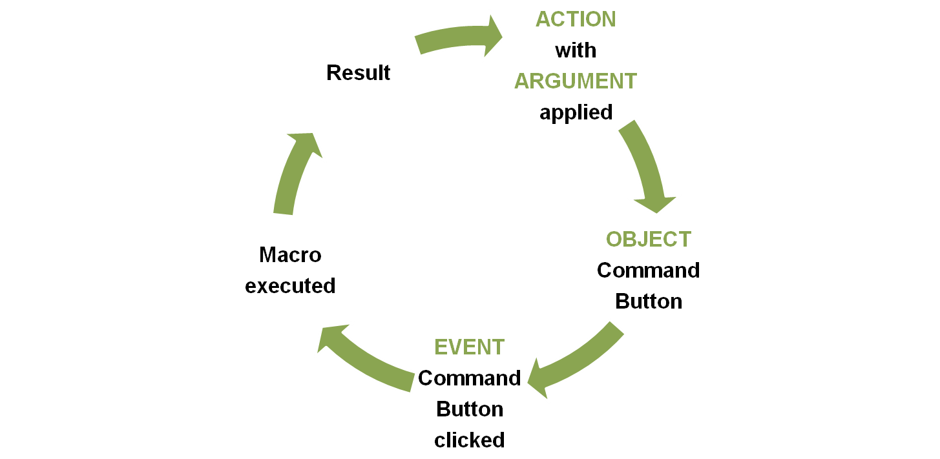
Macro Sequence of Production and Execution

Slide 9
Macro Actions - 1
  A macro Action, or command, is an instruction that informs Access what you want the macro to do.
  There are more than 50 different actions, such as OpenForm.

Slide 10
Macro Actions - 2
  In Access 2010, they are contained in the Action drop-down list of the Macro Designer window and can be selected from the Add New Action drop-down list or from the Action Catalog. Actions in the Action Catalog are grouped by their function.
  To add an Action from the Action Catalog to the macro window, either double-click the macro or click and drag it to the macro window from the Action Catalog.

Slide 11
Creating a Macro In Access - 1
  Plan your macro - you should plan the steps that you want a macro to perform before you record or write it (remember that we discussed the importance of planning in Topic 2, Slide 18).
  As in Microsoft Excel and Word, a macro that is used often can be assigned to a button.
  Unlike Excel and Word, there is no macro recorder.

Slide 12
Creating a Macro in Access - 2
  Creating a macro in Access uses a different method to creating one in Excel or Word, although they can also be written in VBA in the VB Editor.
  In the 2007 version of Access, a new feature was added to the interface (which was also new – the ribbon) called the Macro Designer, which made it easier to create, edit and automate database tasks.
  In the 2010 version, the Macro Designer was developed further and the Data Macro feature was introduced.

Slide 13
Uses of Data Macros
  Verifies that a customer’s payments are up-to-date before allowing additional charges to be made to their account
  Calculates the postage and packaging charges on customers orders in a Sales table
  Calculates the new retail price of a product when the cost of the product is increased
  Ensuring that an email is sent when a particular product needs to be re-ordered

Slide 14
Creating a Macro in 2010 - 1
  Click the Create tab on the Ribbon.
  Click the Macro button on the Macros and Code group on the Ribbon.
  Click the drop-down arrow on the Add New Action drop-down list and select the action, OR
  double-click the action you wish to use in the Action Catalog (click the plus or minus signs to expand or collapse the Actions groups), OR
  Drag an action from the Action Catalog to the Macro window.

Slide 15
Creating a Macro in 2010 - 2
  In the lower part of the window, enter any Arguments for the Action.
  To add more Actions to the macro, move to the next blank Add New Action drop-down list and repeat steps 3-4 above. The macro Actions will be executed in the order that they are listed in the Action column.

Slide 16
Macro Groups
  Several related macros can be stored together in a macro group .
  Each macro in the macro group is given its own unique name to identify where each macro starts and ends.
  Each macro in the macro group must be run separately by referring to the macro group name, followed by the macro name, e.g. mcrPayments. mcrPayments frmPayments refers to the Open frmPayments macro in the mcrPayments macro group.

Slide 17
Autoexec Macro
  This macro is used for running functions when the database is opening, for example, it can automatically open up a particular screen, display a message to the user or output data to another source, such as a spreadsheet.
  To create this type of macro, you need to add your actions in the Macro Designer and save the macro with the name ‘Autoexec’. This name is recognised by Access and it will run the macro as soon as the database is opened.

Slide 18
Data Entry and Validation
  Macros can be created to require that data be entered into a control, or to display a dialogue box that prompts a user for additional information or informs them of an error that they may have made.
  A macro in a user entry form can set the value for the control, field or property. This can make data entry much easier, quicker and more accurate.

Slide 19
Filtering and Finding Fields and Records
  Macros can be written to allow automation of filtering and finding records.
  Macros can also be used to produce message boxes and dialogue boxes to be displayed and allow interaction and help the user.

Slide 20
Printing
  A macro can be created so that instead of finding and opening a specific report, printing it and closing it, a user can print the report simply by clicking on a specific button to which the macro has been assigned.
  A macro can also be created that enables a number of reports to be printed at the same time, instead of opening a report, printing it, opening another report, printing it and so on.

Slide 21
Adding a Macro to a Command Button
  To assign a macro to a Command Button, it must be added to the Command Button’s On Click Property. Thus, when a user clicks the button, the macro is executed.
  Properties such as the OnClick and OnDoubleClick are called events. An event is a specific action that occurs on or with a certain object and is usually the result of an action by a user, such as mouse clicks or the opening or closing of forms.

Slide 22
Navigating between Forms and Records
  Macros can be created to enable navigation between forms and records.
  They can also be created to enable specific control of records or pages in a form.

Slide 23
Running Queries
  Macros can be created that test whether conditions are true or false and then execute particular actions.
  Example: has the customer purchased a product during the last six weeks? If they have not made a purchase, a message will be displayed to the user and the field will be highlighted in red. If they have made a purchase, the field will be highlighted in green.

Slide 24
Security and Macros
  Ensure that you set the security level to at least medium when working with macros in Access.
  Read also the following information from Microsoft Office website:
    http://www.msoffice-tutorial.com/macro-security.php

Slide 25
References
  The Microsoft Office Blog for a demo of Data Macros. (2010). [Available Online] http://tinyurl.com/6cwrumx
  The Microsoft Office Blog for a demo of the Macro Designer. (2009). [Available Online] http://tinyurl.com/67pp46o
  Accessible Data Solutions. (2011). [Available Online]
  http://www.accessibledatasolutions.com/articles10/macrovba.htm

Slide 26
Topic 7 – Using Macros in Microsoft Access
Any Questions?
Notes:
NCC Education - End Slide Master

